Slide 2
General Technical Training for
CEMTEC
FGD-Limestone Grinding Plants and
Equipments thereof
CEMTEC
Cement and Mining Technology GmbH
Ennshafenstrasse 40
4470 Enns, Austria
T: +43 7223 83620 0
F: +43 7223 83620 333
E: info@cemtec.at

Slide 3
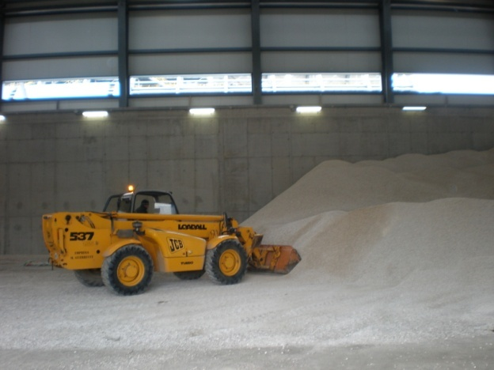
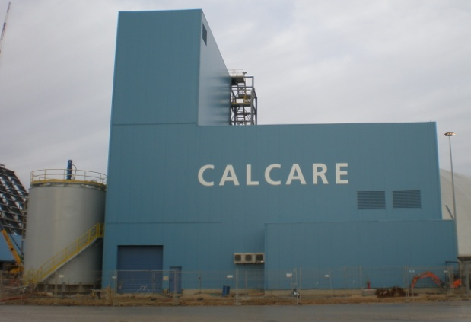
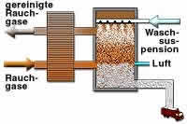
FlueGasDesulfurization-Process
The FGD-limestone grinding plants are installed in coal fired power plants to prepare the „ready-for-use“ limestone-water-suspension. Pre-crushed limestone is milled in a closed wet grinding circuit and afterwards used to react with the flue gas to gypsum in the FGD-towers.
gypsum
dewatering
pre crushed limestone
limestone
grinding
FGD-process

Slide 5
Typical General Layout (including control room layout)

Slide 6
Turn-Key
Plant Layout
(including
Control room)

Slide 7
Main Equipments deliverable by CEMTEC
-limestone transport and daily storage area including pre-crushing (if necessary)
-limestone dosing belts
-wet grinding mills including lubrication systems
-process water dosing by means of regulation valves
-limestone slurry tank (circulation tank after mill) including agitator
-slurry pump including additional stand-by pump (on demand)
-hydrocyclone clusters including stand-by cyclones (1 spare or more according demand)
-limestone slurry piping system including valves and distribution into limestone slurry storage tank (according detailed take over point requirements)
-process water piping according detailed take over point requirements
-instrumentation
-auxiliary media piping such as instrument air, purging water, cooling water etc.
-electrical equipment and control system (MCC, FCC, PLC according detailed project specification)

Slide 8
Auxiliary Equipments deliverable by CEMTEC (on demand)
-secondary structures as piping supports, maintenance platforms and walkways
-sound deadening covers for ball mills
-grinding media filling devices
-grinding media sorting machine
-maintenance handling systems (e.g. monorail crane)

Slide 9
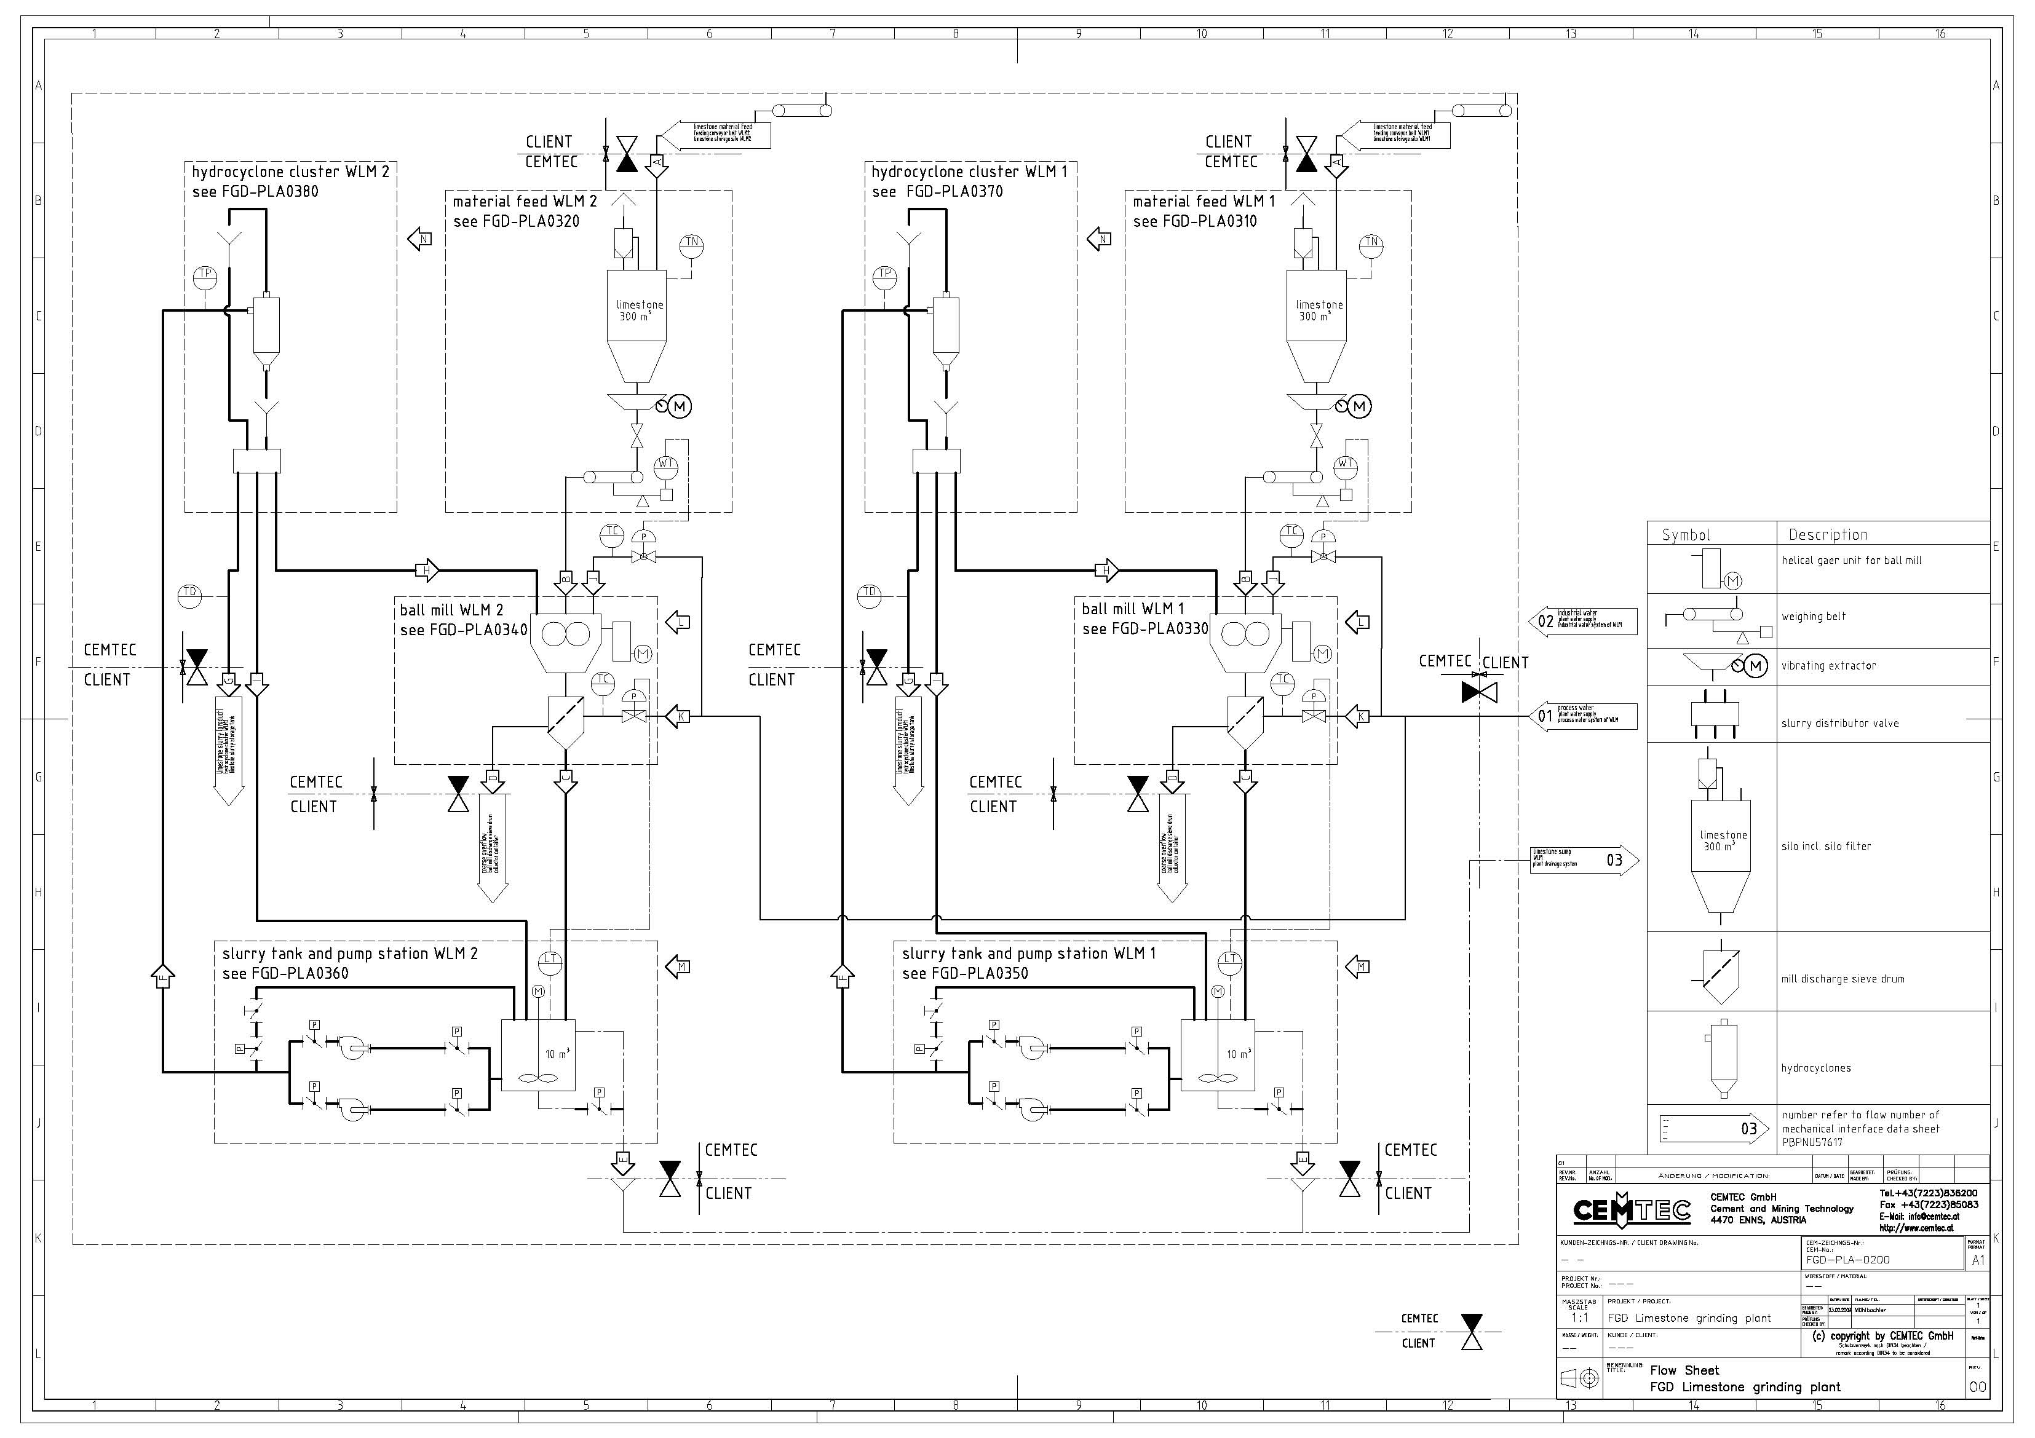
Flow-sheet

Slide 10
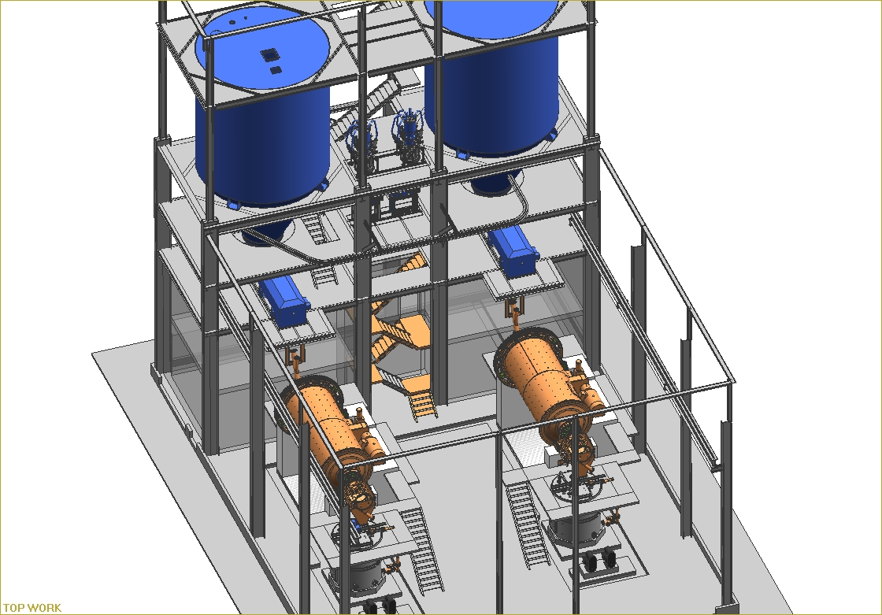
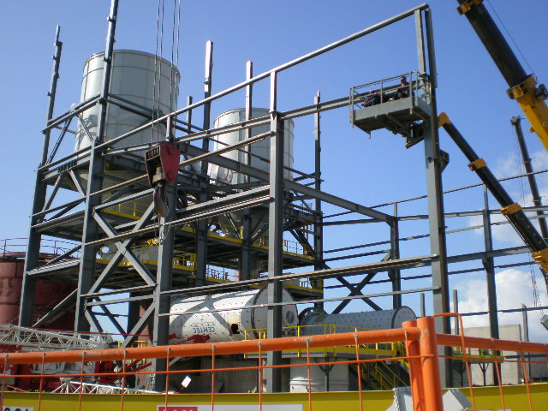
CEMTEC-turn-key plant

Slide 11
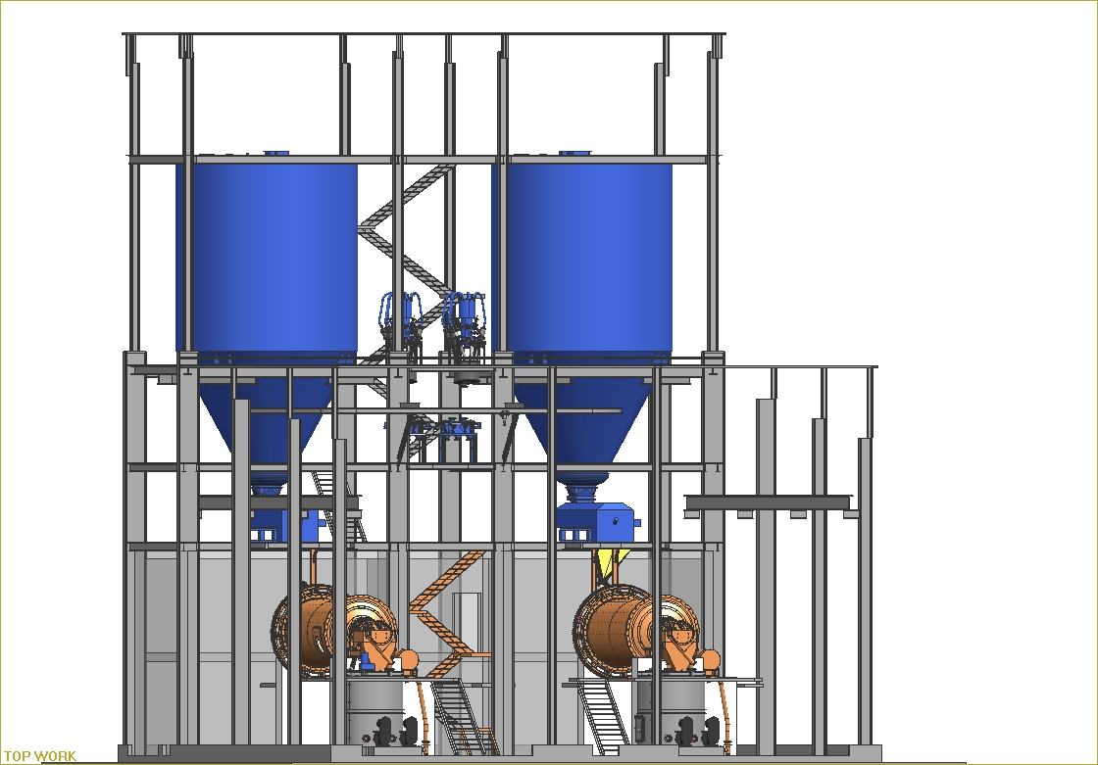
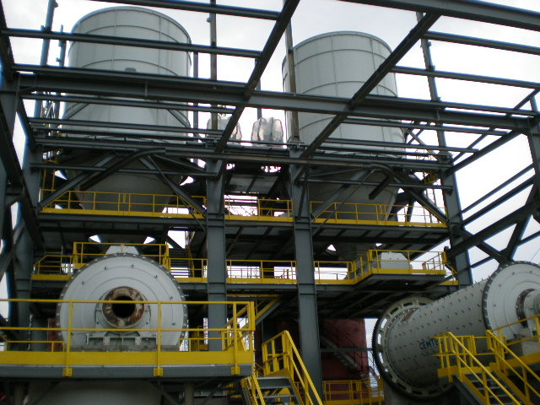

Slide 12
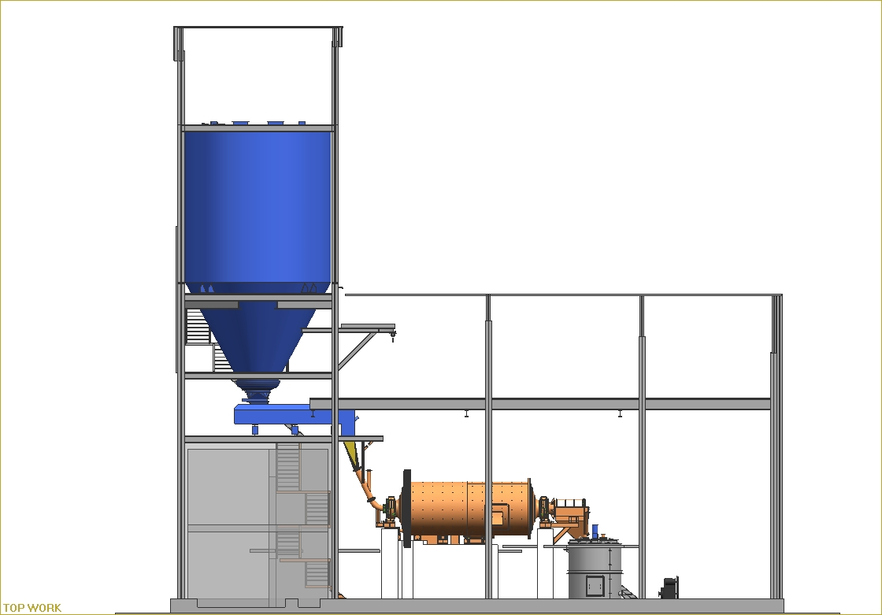

Slide 13
General Data / Utilities
feeding material pre-crushed limestone (recommended maximum grain size 20 mm)
final product limestone slurry (normal fineness P90 = 44 μm)
process water
purging water
compressed air/service air
compressed air/instrument air

Slide 14
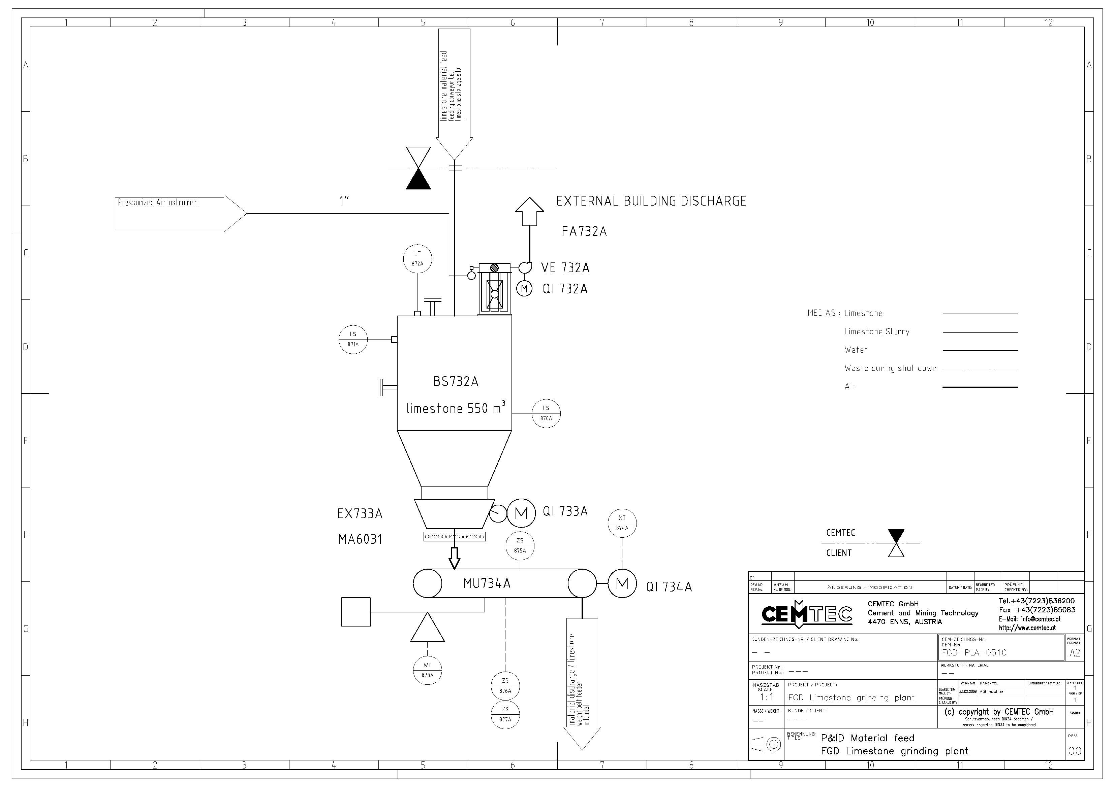
Daily storage silo and material feed

Slide 15
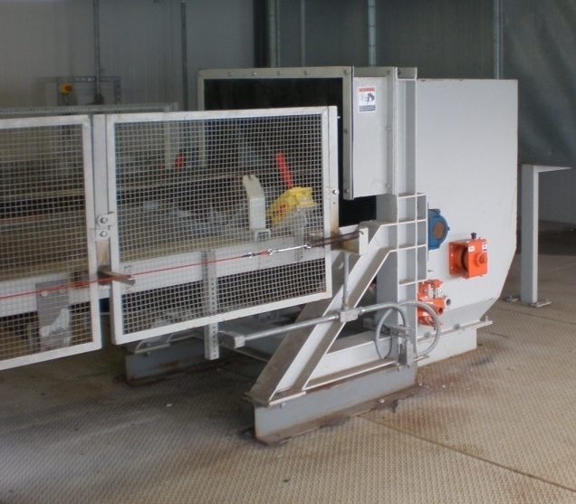
Daily storage silo
and material feed

Slide 16
Grinding mill including auxiliaries thereof

Slide 17
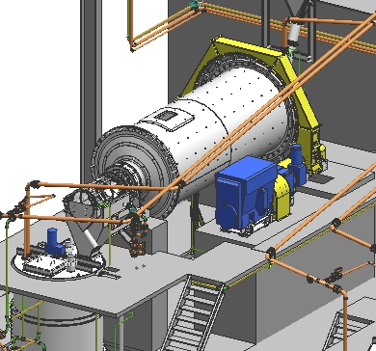
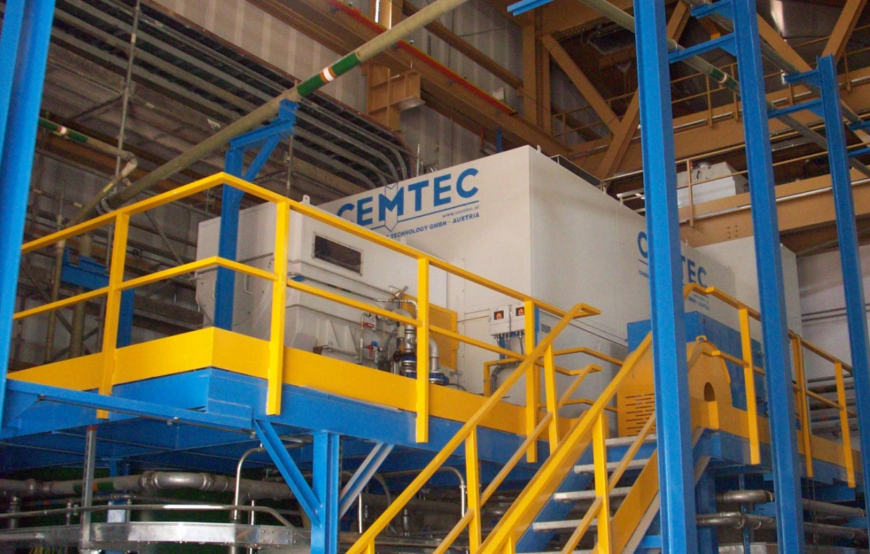
Grinding mill including auxiliaries thereof

Slide 18
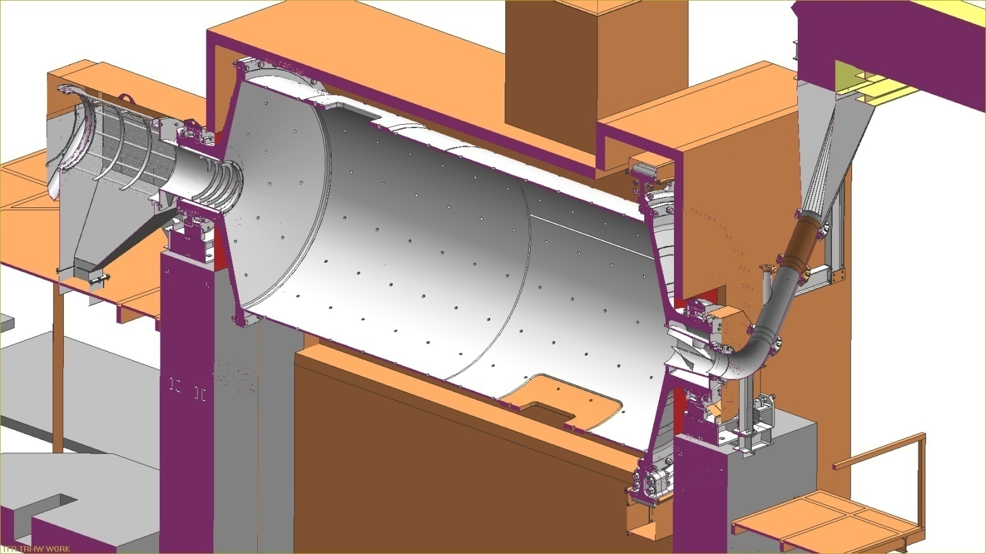
Wet grinding mill section (lining not shown)

Slide 19
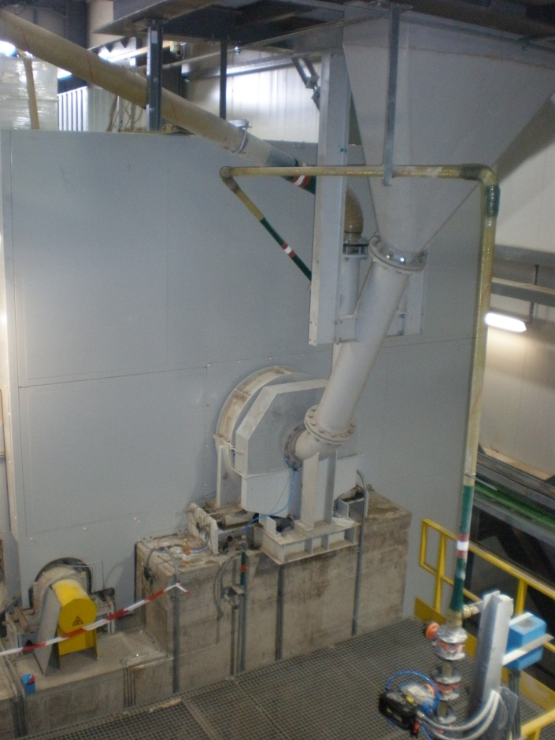
Grinding mill inlet

Slide 20
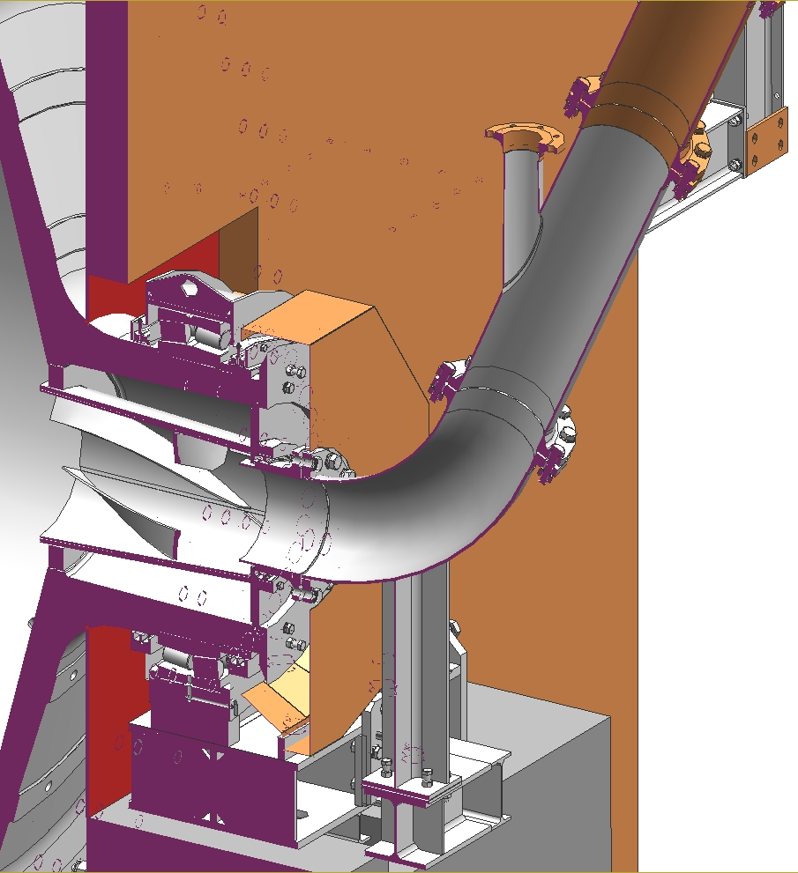
Grinding mill inlet detail
Dilution water mill inlet

Slide 21
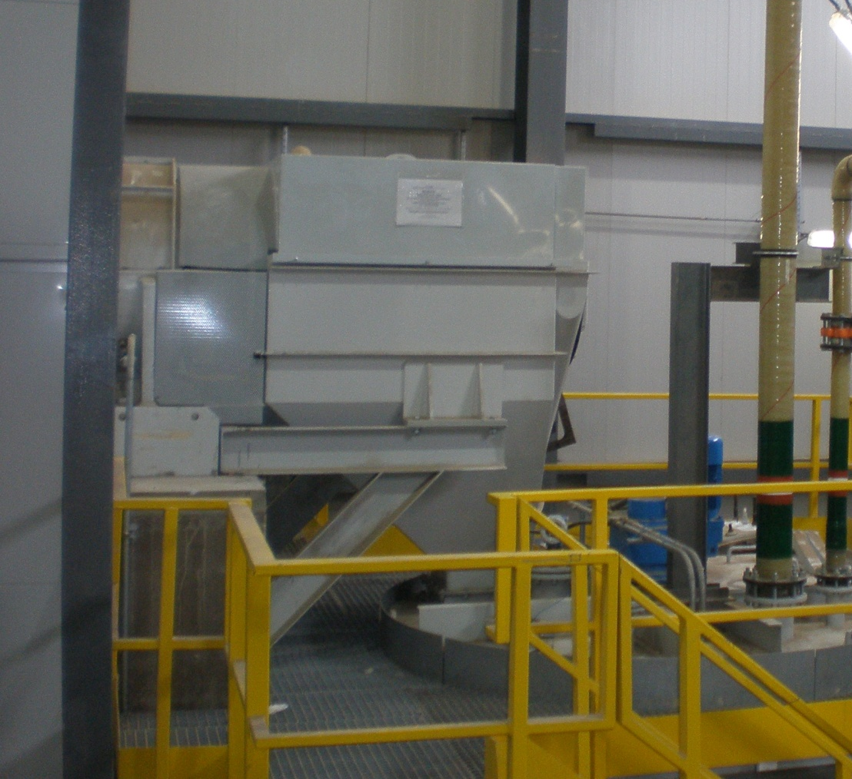
Grinding mill discharge

Slide 22
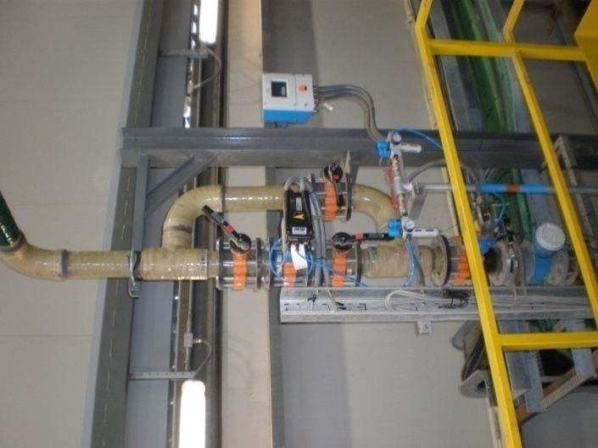
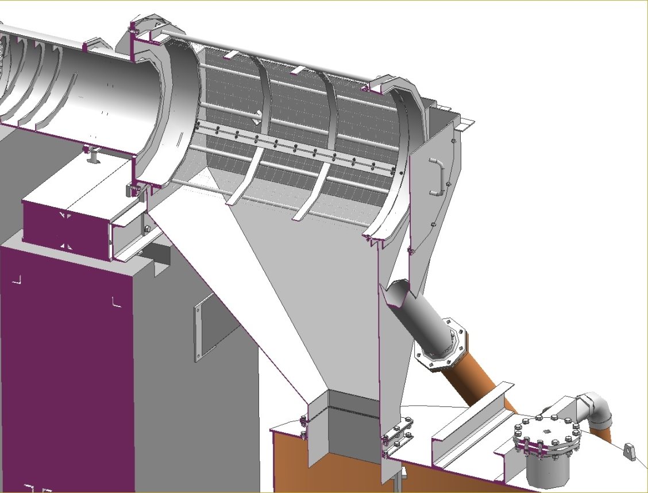
Dilution water
mill discharge
Grinding mill discharge detail

Slide 23
Circulation tank and slurry pumps

Slide 24
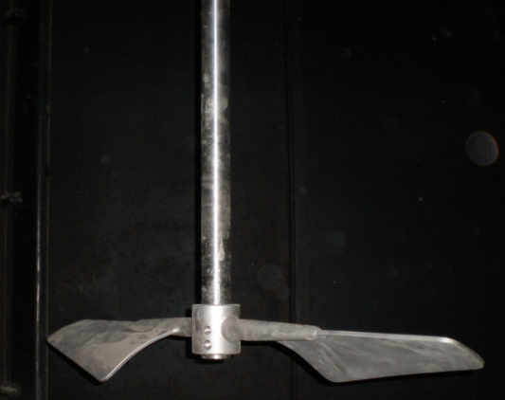
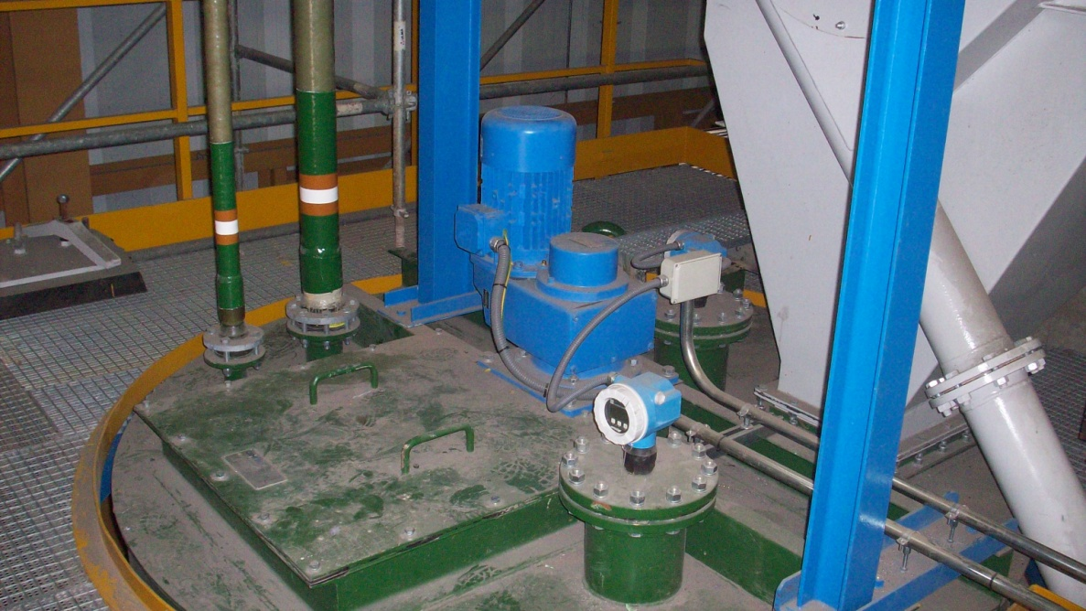
Slurry circulation tank
with
agitator

Slide 25
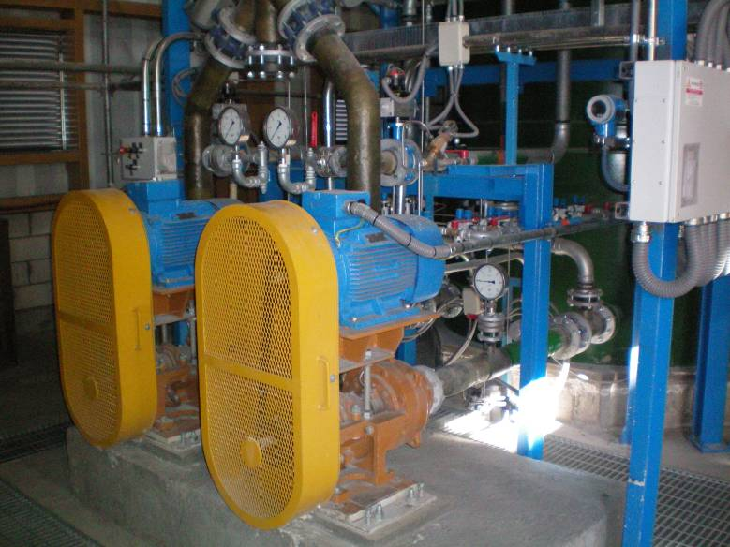
Circulation tank and slurry pumps

Slide 26
Hydrocyclones and density measurement

Slide 27
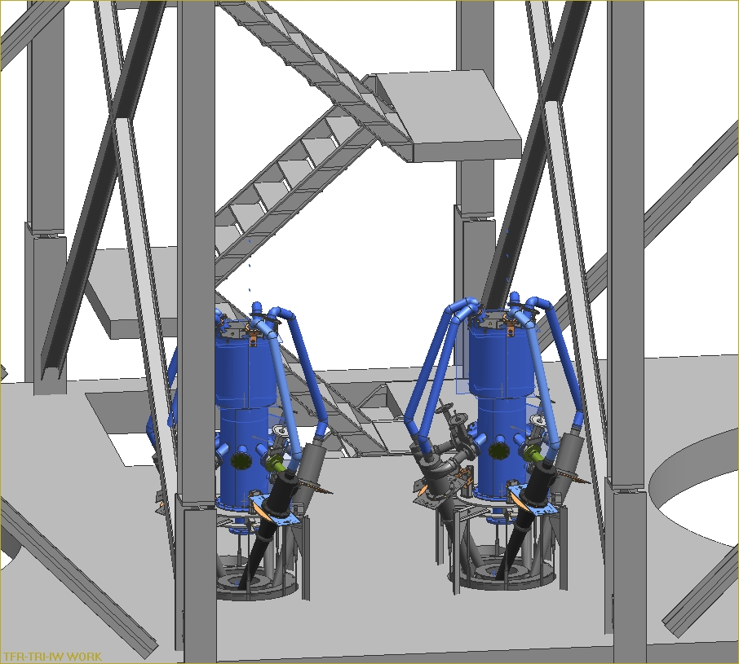
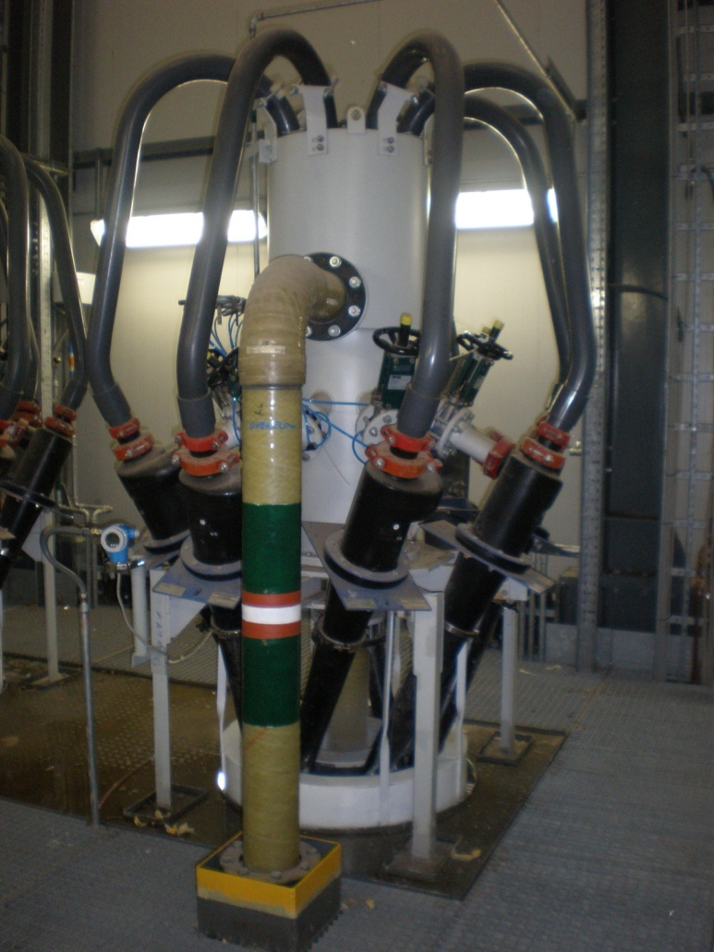
Hydrocyclone clusters

Slide 28
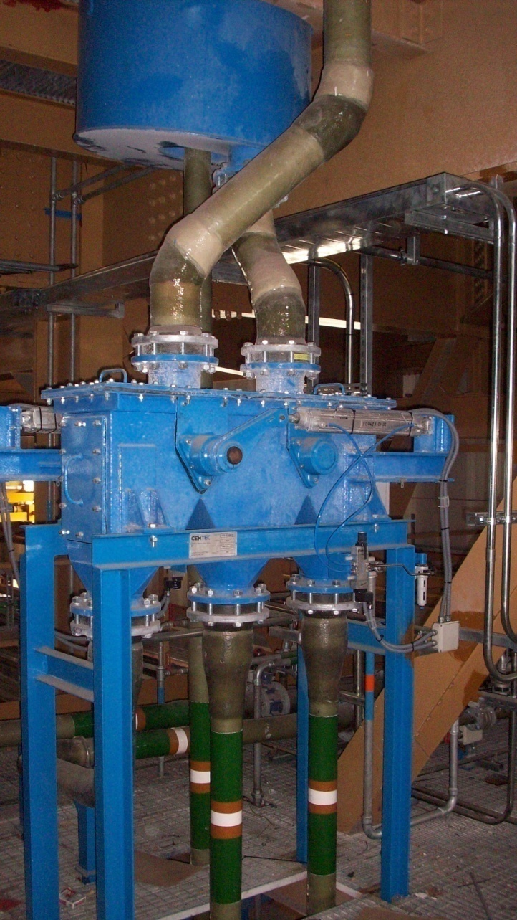
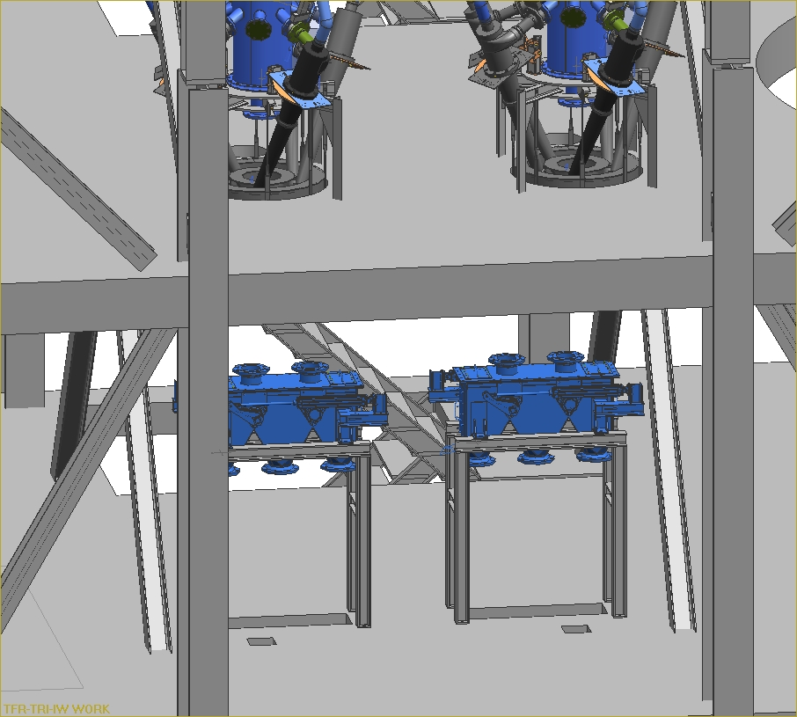
Slurry diverter valve

Slide 29
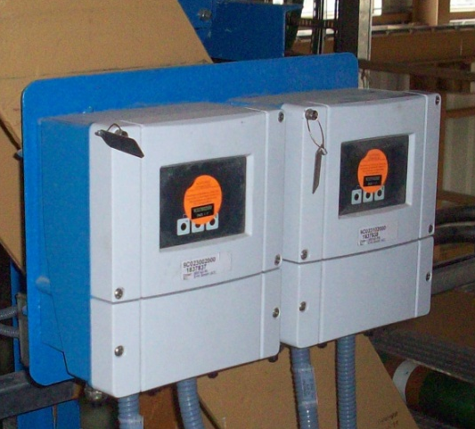
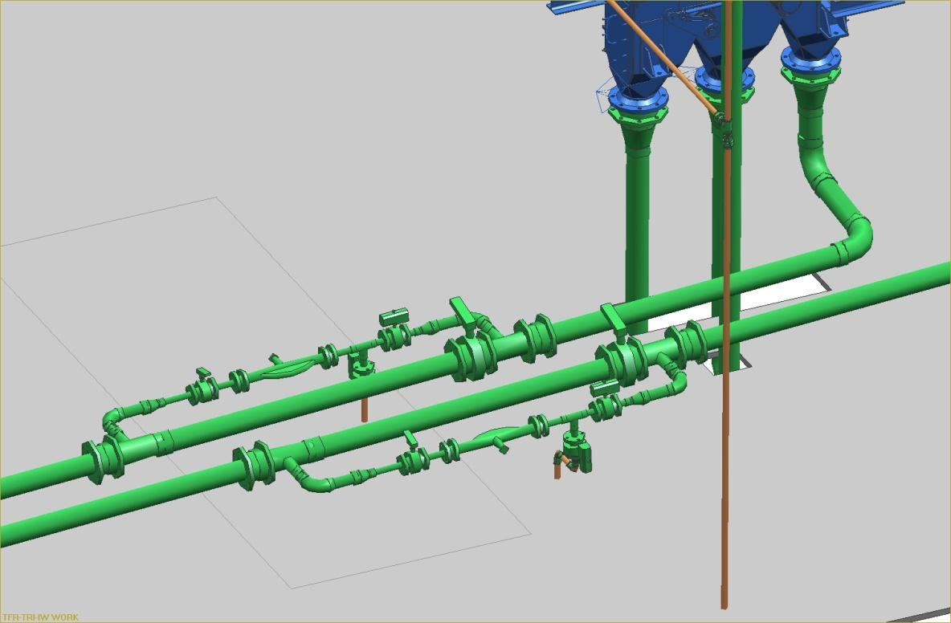
Density measurement

Slide 30
Limestone slurry (product) tank

Slide 31
Valves and piping

Slide 32
limestone slurry piping

Slide 33
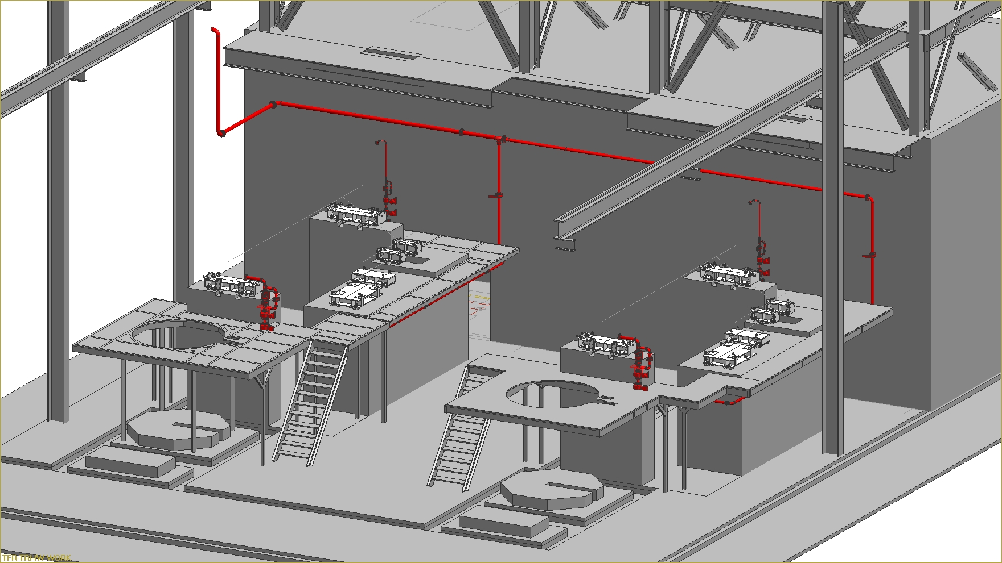
process water piping

Slide 34
purging water piping

Slide 35
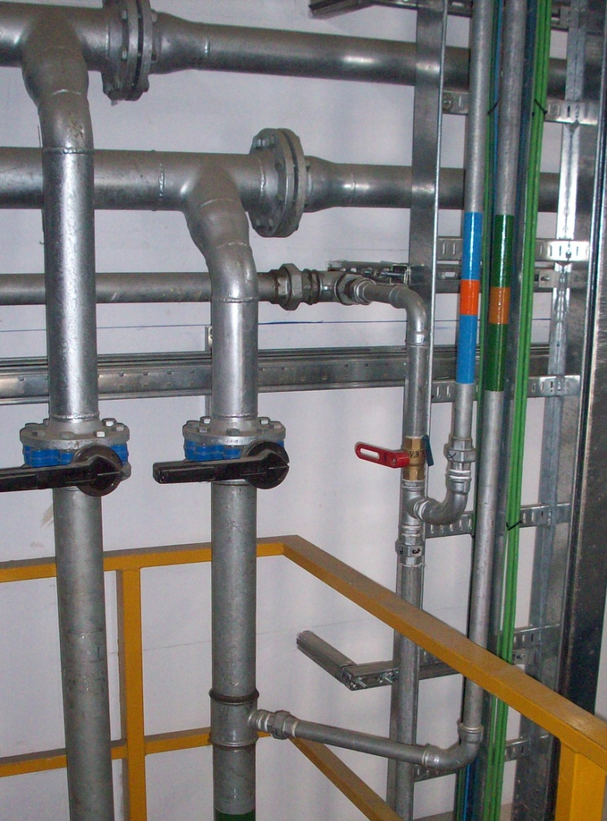
Starting with cut of valves
at take over point(s)

Slide 36
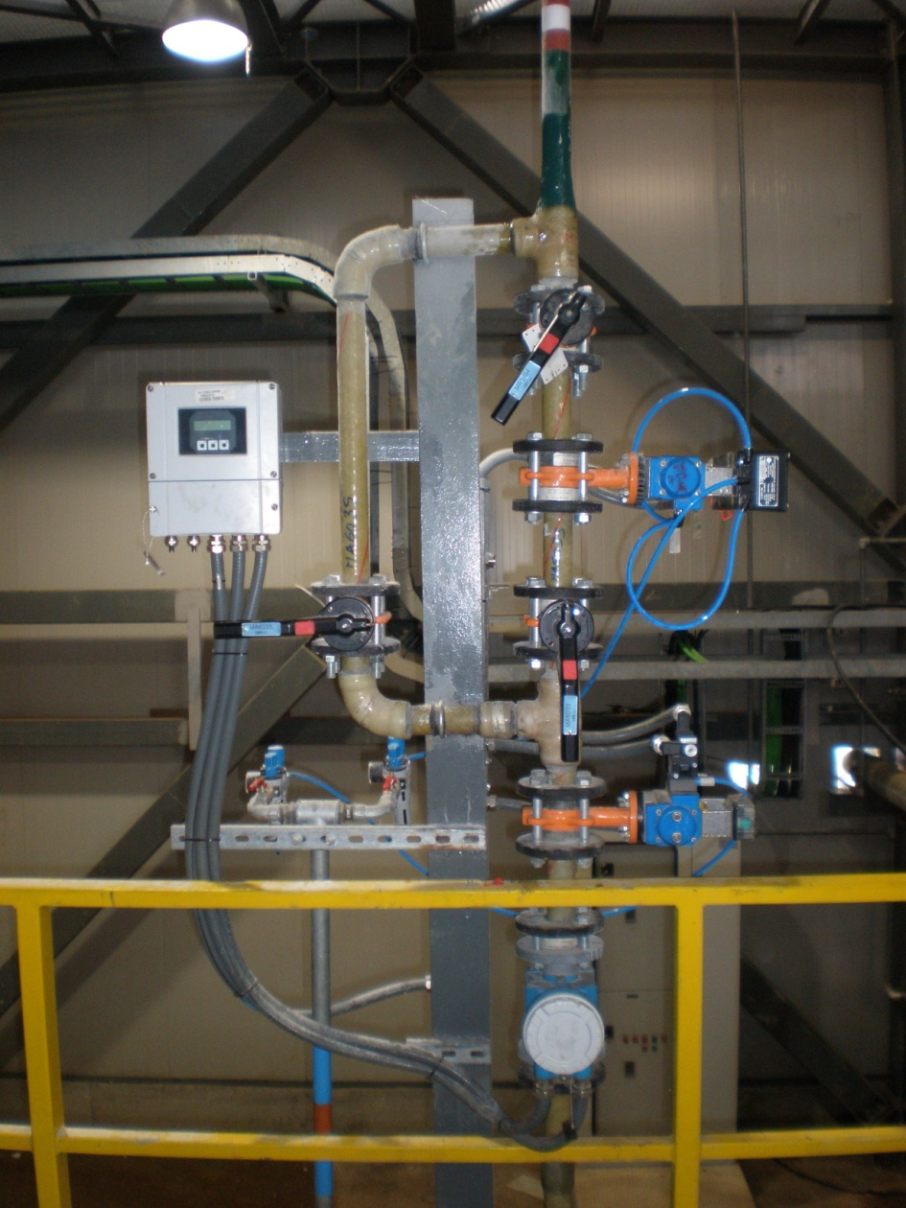
flow control valves for dilution water
process piping for limestone slurry

Slide 37
e.g. pneumatic actuated valves
including limit switches for end positions

Slide 38
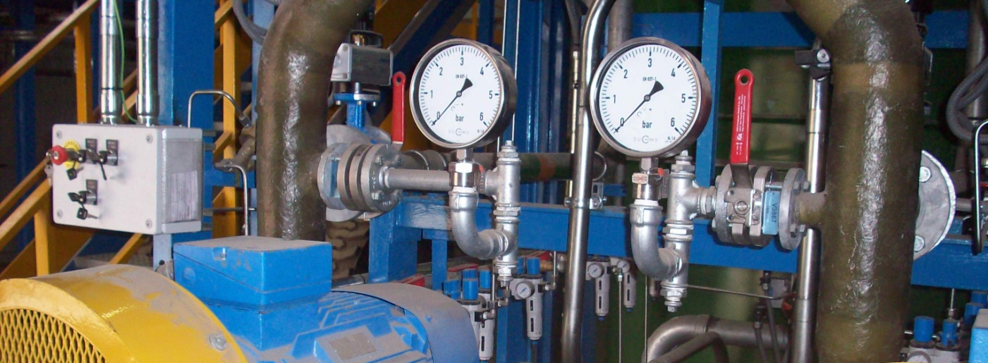
instrumentation
local control boxes and local indication

Slide 39
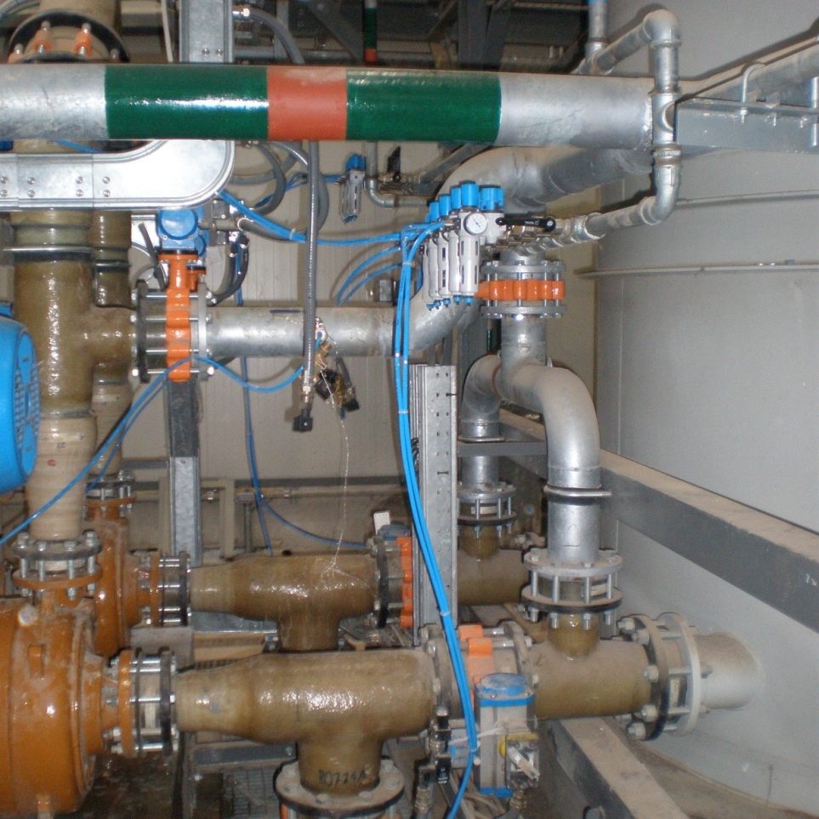
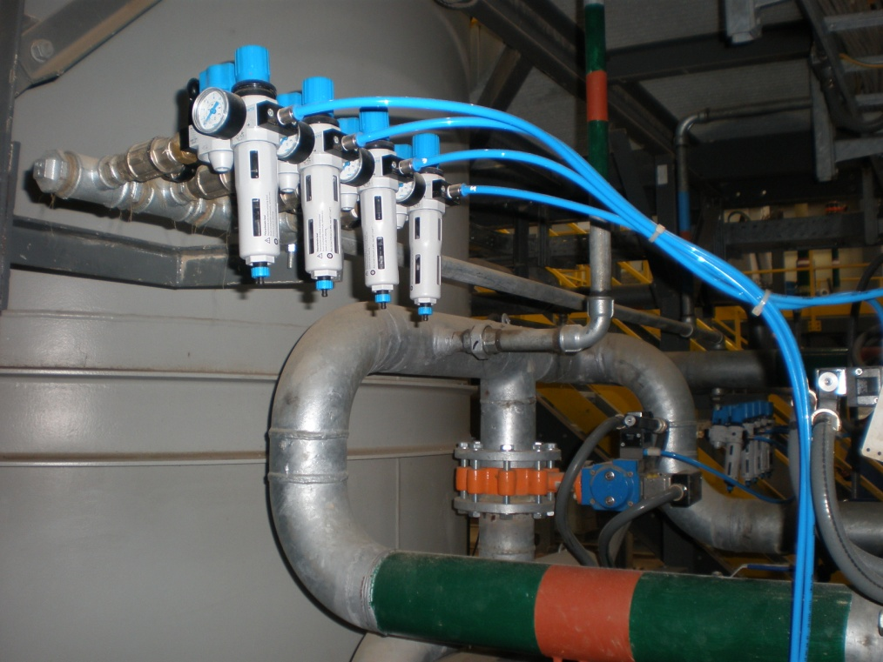
Auxiliary media piping
purging water piping
instrument air for pneumatic actuators

Slide 40
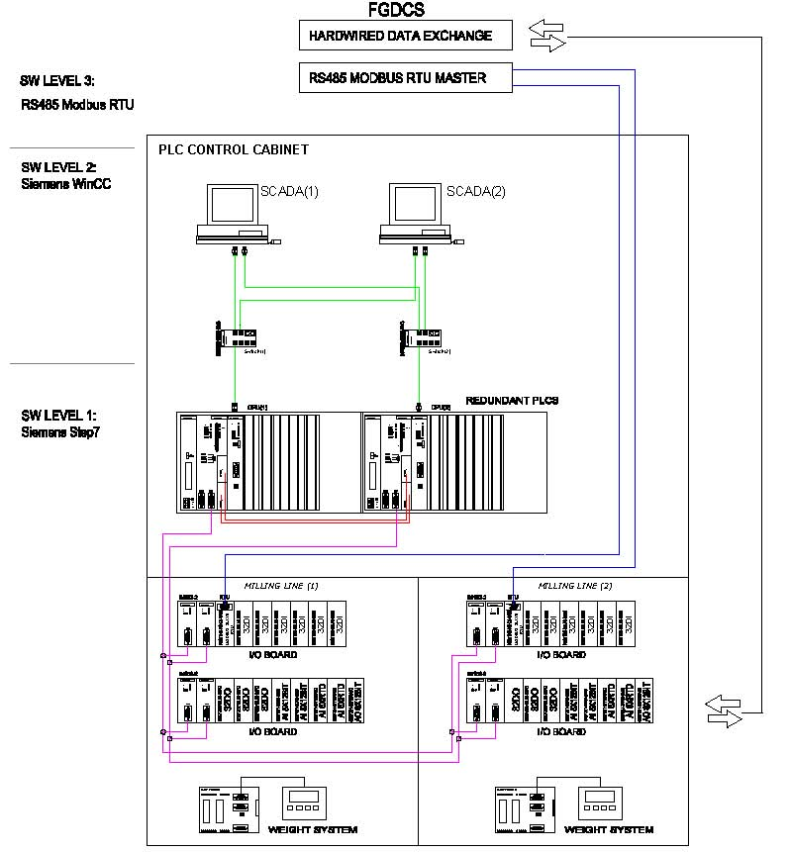
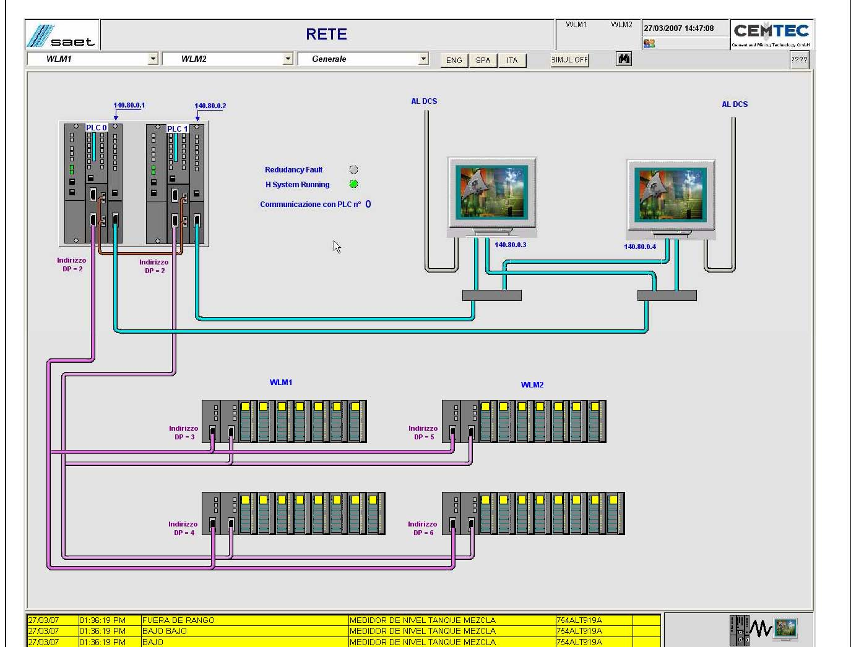
Control system

Slide 41
Operating modes
The operating modes managed by the PLC are the following :
Maintenance (with local selector on “LOCAL”);
manual (with local selectors on “REMOTE”);
Automatic (with local selectors on “REMOTE”);
No Automatic Sequences including Subsequences
01 Grinding circuit production sequence
02 Grinding circuit standby sequence
03 Central lubrication sequence
04 Gear rim lubrication sequence
05 Main/standby pump changeover sequence
06 Mill antisedimentation sequence
07 Mill main drive sequence
08 Slurry pump circuit purging sequence
09 Mill purging sequence
10 Hydrocyclones and mill purging sequence
11 Hydrocyclones purging sequence
12 Tank emptying sequence
13 Knife gates purging sequence
14 Mill inlet purging sequence
15 Mill discharge coarse overflow purging sequence

Slide 42
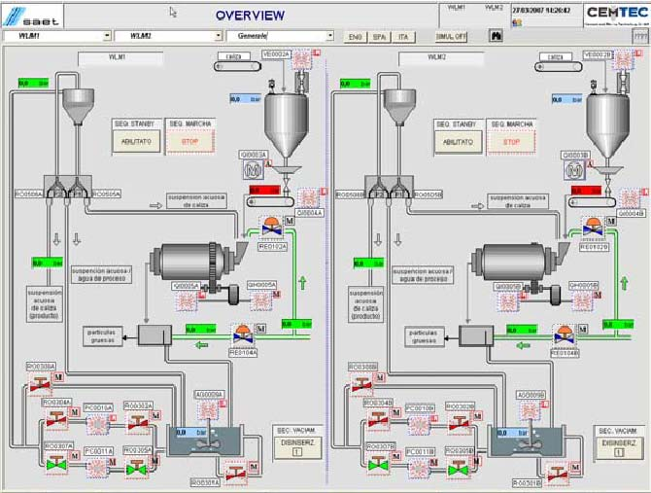
HMI - Plant overview

Slide 43
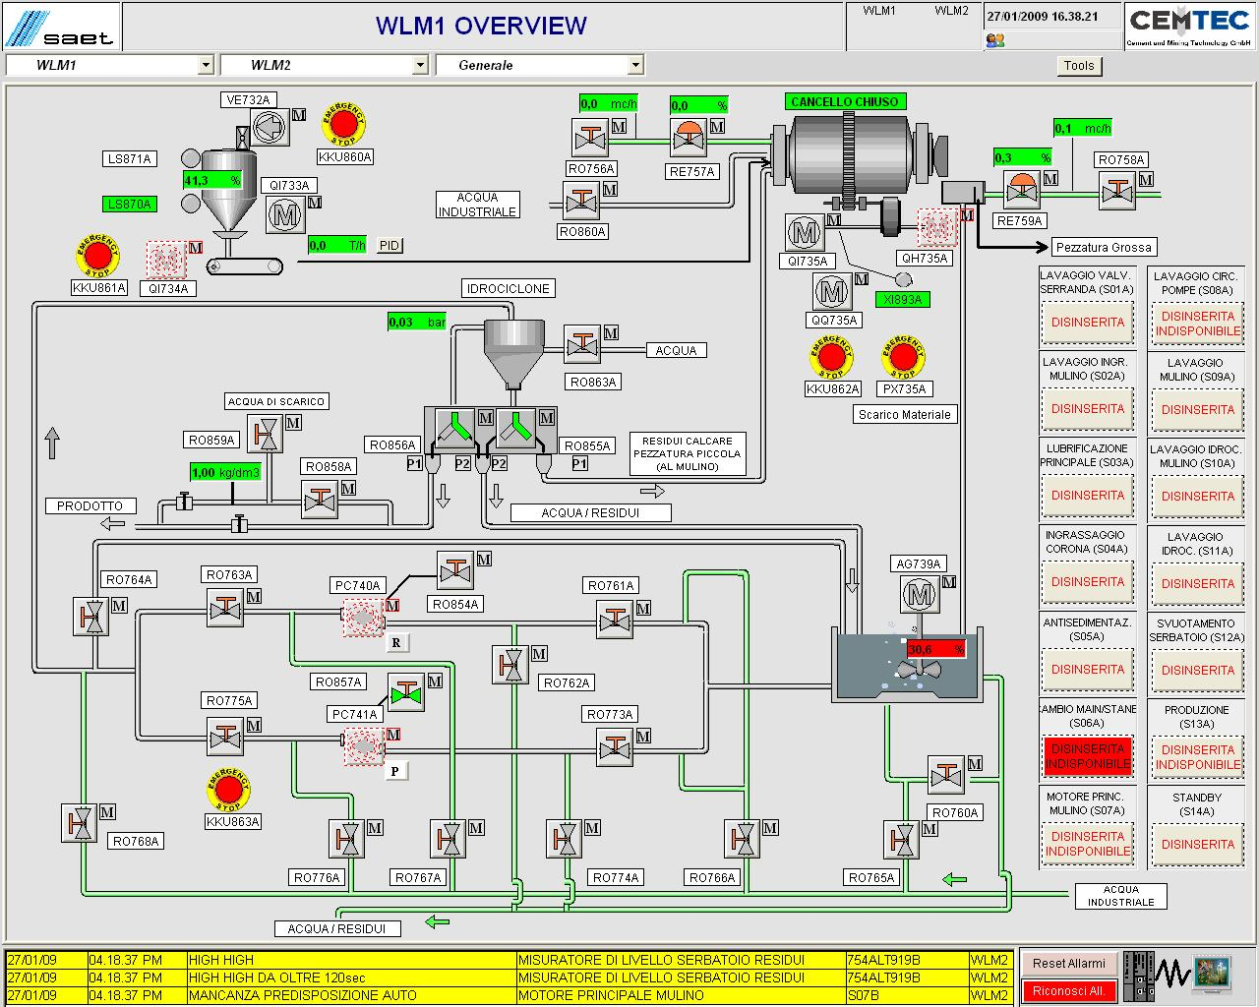
HMI – Grinding circuit overview

Slide 45
HMI – Grinding mill overview

Slide 46
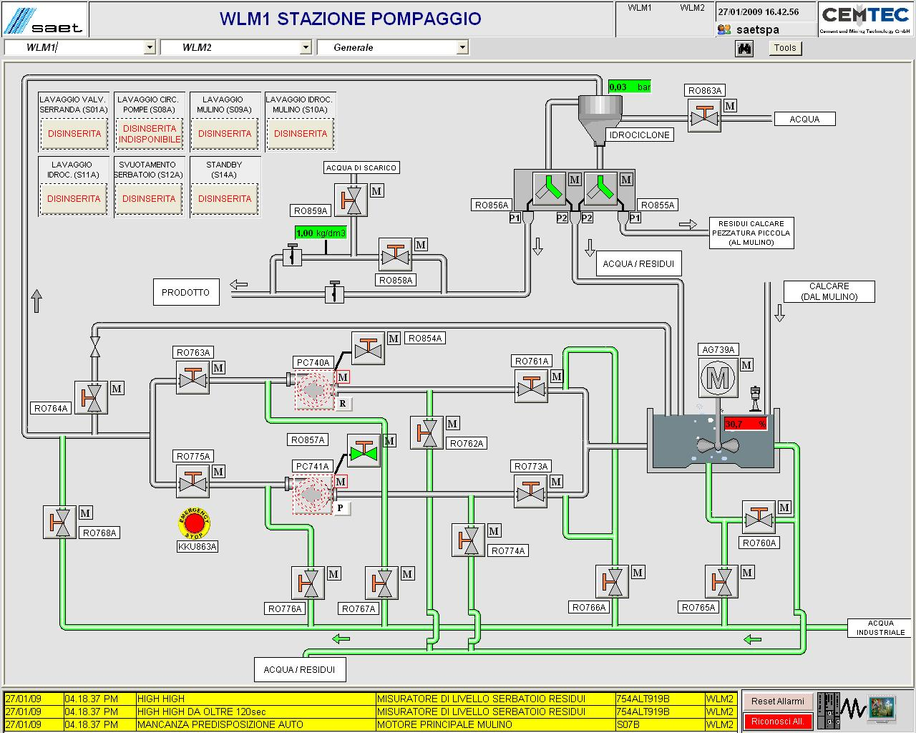
HMI – Pump and hydrocyclone overview

Slide 47
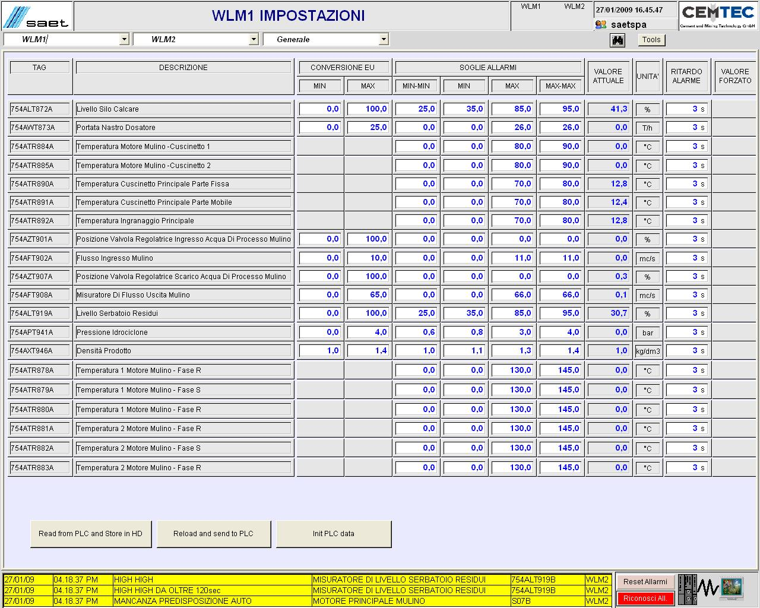
HMI – Settings (password protected)

Slide 48
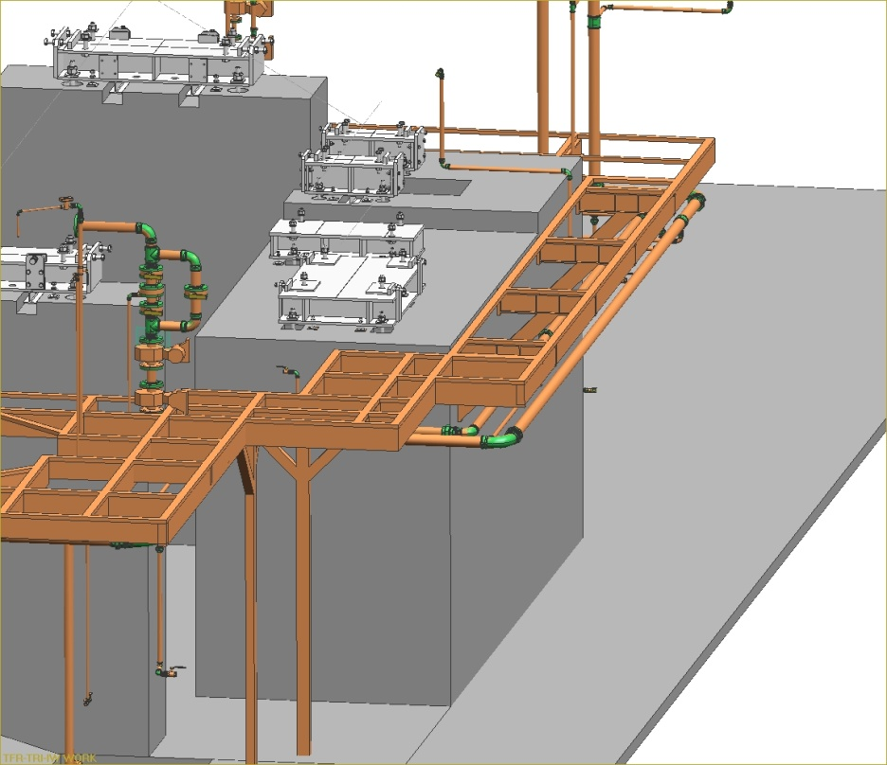
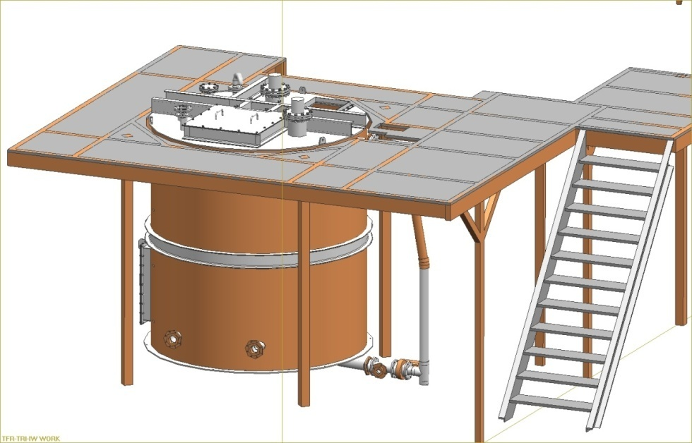
Auxiliary Equipments
maintenance platforms and walkways

Slide 49
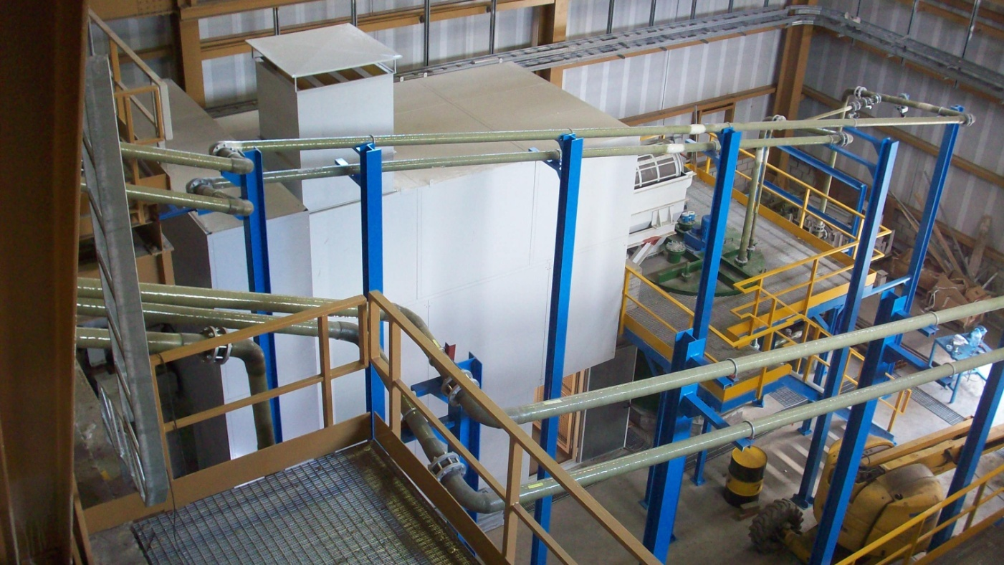
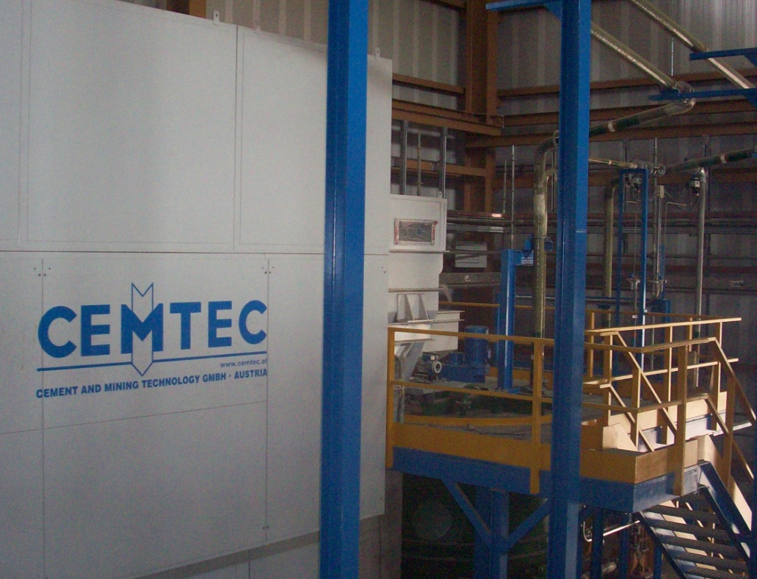
sound deadening covers for ball mills

Slide 50
grinding media filling/refilling devices

Slide 51
grinding media sorting machine

Slide 52
Thank you!

